Slide 1
BAND THEORY OF SOLIDS

Slide 2
Content
1.Introduction
2.Semiconductors
3.Energy band in solids
4. Conduction band, Valance band and Forbidden gap
5.Insulators, Conductors and Semiconductors
6.Electrons and holes in semi conductors
7.Intrinsic semiconductor
8.Doping of a semiconductor
9.Extrinsic semi conductors
10.N-type semi conductor
11.P-Type semiconductor

Slide 3
SEMICONDUCTORS
Semiconductors have resistivity between good conductors and insulators.
The resistivity of semiconductor lies approximately in between 10 ⁻² ohm m and 10 ⁴ ohm m at room temperature.
The resistance decreases with increase of temperature over a particular temperature range in the case of a semiconductor .

Slide 4
This is contrary to that of metallic conductors, for which the resistance increases with increase of temperature.
The elements that are classified as semiconductors are Si.Ge,In etc.
Germanium and Silicon are most commonly used semiconductors.

Slide 5
Band Theory of Solids
In order to account for decreasing resistivity with increasing temperature as well as other properties of semiconductors, a new theory known as the band theory is introduced.
The essential feature of the band theory is that the allowed energy states for electrons are nearly continuous over certain ranges, called energy bands, with forbidden energy gaps between the bands.

Slide 6
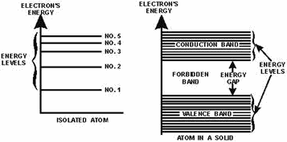
ENERGY BANDS IN SOLIDS
There are discrete energy levels in the case of an isolated atom.

Slide 7
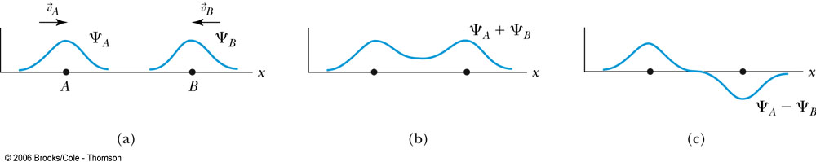
Band Theory of Solids
Consider initially the known wave functions of two hydrogen atoms far enough apart so that they do not interact.

Slide 8
Band Theory of Solids
Interaction of the wave functions occurs as the atoms get closer:
An atom in the symmetric state has a nonzero probability of being halfway between the two atoms, while an electron in the antisymmetric state has a zero probability of being at that location.
Symmetric
Antisymmetric

Slide 9
Band Theory of Solids
In the symmetric case the binding energy is slightly stronger resulting in a lower energy state.
Thus there is a splitting of all possible energy levels (1s, 2s, and so on).
When more atoms are added (as in a real solid), there is a further splitting of energy levels. With a large number of atoms, the levels are split into nearly continuous energy bands, with each band consisting of a number of closely spaced energy levels.

Slide 10
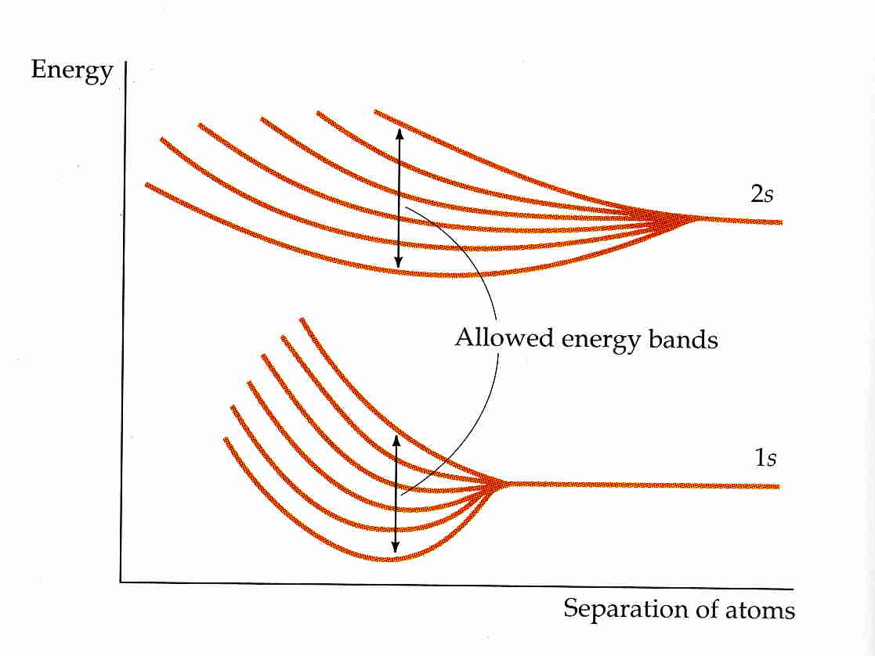
6 atoms

Slide 11

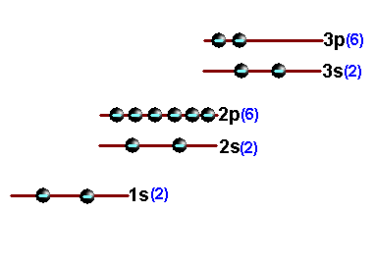
Electron arrangement in a silicon atom

Slide 12

The completely filled levels are called core levels and the electrons filling these levels are called core electrons.
The electrons in the outermost level are called valence electrons.
The partially filled outermost level is called valence level and the permitted levels which are vacant are known as conduction levels.

Slide 13

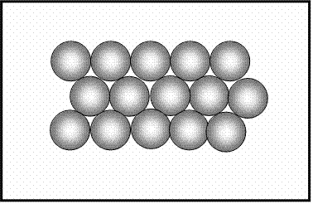
In solids , the atoms are arranged in a systematic space lattice and each atom is influenced by neighbouring atoms.
The closeness of atoms results in the intermixing of electrons of neighbourring atoms.

Slide 14

Due to inter mixing of electrons, the number of permissible energy levels increases.
Instead of a single energy level , there will be bands of energy levels.
A set of such closely packed energy levels is called an energy band.

Slide 15

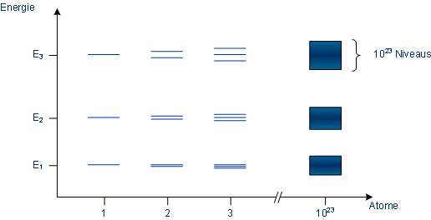
28 Gram of silicon contains 6.023 x 10²³ atoms
ENERGY
ATOMS
ATOMS

Slide 16
A band which is occupied by the valence electrons or a band having highest energy is defined as valence band.
The valence band may be partially or completely filled.
This band can never be empty.

Slide 17
In some materials valence electrons are loosely attached to the nucleus.
Even at room temperature , some of the valence electrons leave the valence band.
They are called free electrons.

Slide 18
They are responsible for conduction and so they are called Conduction electrons.
The band occupied by this electrons are called conduction Band.
This band may be empty or partially filled.

Slide 19
Energy bands in Silicon crystal
4s,4p,4d,4f
Completely
Vacant
Conduction
Levels
3 d Completely Vacant
3p Partially Filled
Valence
Levels
3s Completely Filled
2p Completely Filled
Core
Levels
2s Completely Filled
1s Completely Filled

Slide 20
Energy bands in Silicon crystal
Conduction Band ( Empty or Partially filled Band)
Valence Band Fully or Partially filled Band)
Completely filled Band

Slide 21
Energy bands in Silicon crystal
Valence Band
Forbidden Energy Gap 1.11 eV
Conduction Band

Slide 22
The separation between valence band and conduction band is known as forbidden energy gap.
If an electron is to be transferred from valence band to conduction band, external energy is required, which is equal to the forbidden energy gap.

Slide 23

Insulators
Conduction Band
In an insulator, the forbidden gap is very large and in general is more than 3eV.
No electron is available for conduction.
Large amount of energy is needed to move electron from valance band to conduction band.
FORBIDDEN GAP
Valence Band
Energy
Filled Band

Slide 24
Insulators
Conduction Band
In the case of materials like Glass at 0 K, valance band is completely filled and the forbidden gap energy is of the order of 10 eV.
High electric field can not move electron from valance band to conduction band.
When the electron is supplied with very high energy, then it can jump across the forbidden gap.
FORBIDDEN GAP
Around 10eV (Glass)
Valence Band
Energy
Filled Band

Slide 25
Insulators
Conduction Band
When the temperature is increased, then, some electrons will move to go to conduction band. This is the reason why certain materials which are insulators at room temperature become conductors at high temperature.
The resistivity of an insulator lies approximately between 10 ¹¹ and 10 ¹⁶ Ωm
FORBIDDEN GAP
Energy
Valence Band

Slide 26
Semiconductors
In the case of semiconductors the forbidden gap is very small.
At 0K the conduction band is empty and the valence band is completely filled.
When a small amount of energy is supplied, the electrons can easily jump the forbidden gap.
The conductivity of a semiconductor is of the order of
10 ²mho m⁻¹
Conduction Band
FORBIDDEN GAP
Around 0.7eV (Ge) and
1.1 eV (Si)
Energy
Valence Band
Filled Band

Slide 27
Conductors
In conductors there is no forbidden gap.
The valence band and the conduction band overlap.
The electrons from valence band freely enter into the conduction band due to overlapping of bands.
Therefore very low potential difference can cause continuous flow of current.
Conduction Band
Energy
No forbidden gap
Valence Band

Slide 28
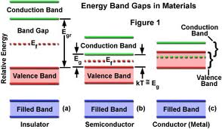
Comparison of Insulator ,Semiconductor and Conductor

Slide 29
Electrons and holes in semiconductors
At absolute 0 temperature, in a pure semiconductor the valence band is completely filled and the conduction band is vacant.
At 0 K
Conduction Band
Energy
Valence Band
Electron

Slide 30
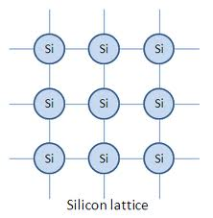

Slide 31
Electrons and holes in semiconductors
At Room temperature
At room temperature some of the electrons get energy to break the covalent bond and moves in to the conduction band.
Conduction Band
Energy
Valence Band
Electron
Hole

Slide 32
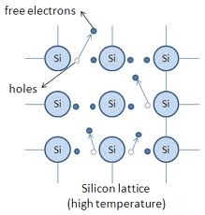

Slide 33
The electrons in a an intrinsic semiconductor, which moves in to the conduction band is called as intrinsic carriers.
The vacancy created in the valence band is called as Hole.
The importance of hole is that, it may serve as a carrier of electricity in the same manner as the free electron, but in opposite direction.

Slide 35
Gr III | Gr IV | Gr v
B | C
Al | Si | P
Ga | Ge | As

Slide 36
Group 5 atoms have one more electron in their outer shell than group 4 elements such as silicon.
Like all atoms, they have the same number of protons as electrons.
This extra electron (which is negatively charged as are all electrons) is not tightly bound into the crystal lattice of the silicon atoms and can be easily separated from its parent atom with the addition of only a little energy.

Slide 37
The thermal energy at room temperature is easily enough to do this, meaning that the electron is essentially free to move from the moment the phosphorus atom is introduced into the silicon crystal.

Slide 38
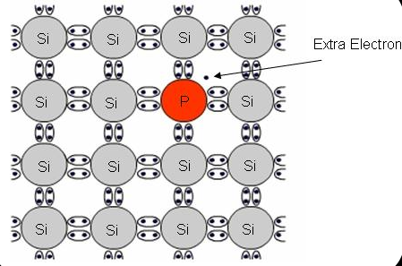
FORMATION OF N - TYPE MATERIAL

Slide 39
Group 3 atoms have one less electron than silicon so when they are introduced into the crystal, there is a ‘hole' where one extra electron should be.
Electrons from neighbouring atoms can move into this hole, leaving a hole where they used to be which is in turn filled by another neighbouring electron.

Slide 40
In this way, the hole can move through the crystal lattice.
Although the hole carries no charge, the electrons which are moving into it represent a negative charge moving in the opposite direction to the hole.
Therefore, we can think of the hole as a moving positive charge.

Slide 41
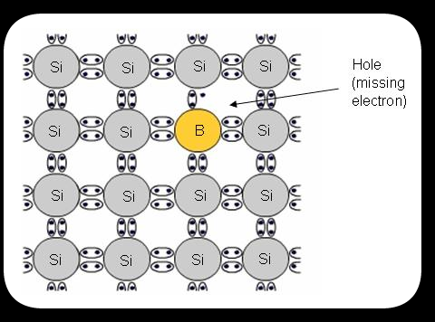
FORMATION OF P - TYPE MATERIAL

Slide 42
THE END
Thank you

